Slide 1
The Circuit Less Travelled: A Path of Gentrification Through Colorado Neighborhoods
Weston Grewe and Angela Morrison

Slide 2
Motivation
What is gentrification?
“The process whereby the character of a poor urban area is changed by wealthier people moving in, improving housing, and attracting new businesses, typically displacing current inhabitants in the process.”
What impact does it have on our neighborhoods?
Schools
Home prices
Quality of life
What policy changes can we make to reduce these negative effects?
Prohibit large scale development
Reduce/freeze property taxes for long-term residents

Slide 3
The Data
5-year period aggregate survey data at the neighborhood level for the state of Colorado (2006-2010,2010-2015,2015-2019)
Columns related to gentrification:
Average income
Highest level of education
Demographic breakdown
Something to keep in mind: these variables all use different scales for their values

Slide 4
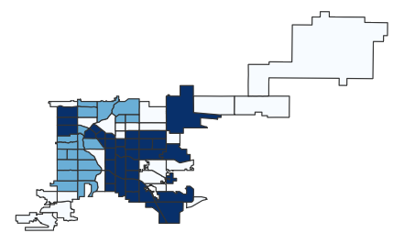
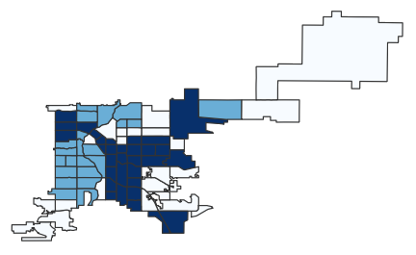
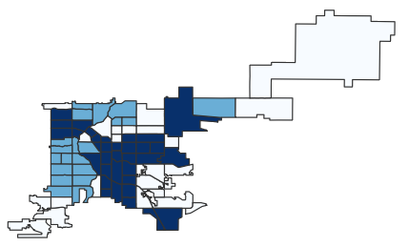
K-Means Clustering
2006
2010
2015

Slide 5
Describing the Clusters
2006
 | Cluster 1 | Cluster 2 | Cluster 3
Med Income | 54,000 | 27,000 | 15,000
% White | 79 | 53 | 21
% Hispanic | 8 | 26 | 66
% Black | 4 | 14 | 7
% College | 65 | 37 | 14
% Poverty | 4 | 15 | 29

Slide 6
What do the Circuits Mean?
Start
Step 1
Step 2
End
We get an idea of where people are moving.
For us, we are looking at which of the lower privilege neighborhoods are being impacted
Example:

Slide 7

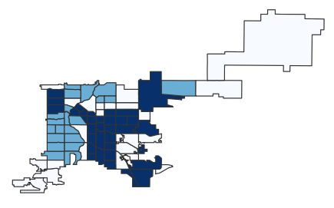

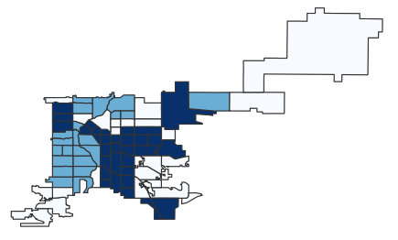
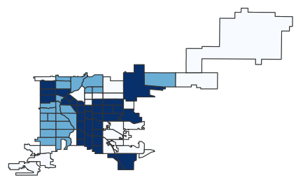

2006 to 2010 Circuit Walk
Start
Step 1
Step 2
Step 3
Step 4
Step 5
Step 6
End

Slide 8
Policy Recommendations
Engage and educate existing community residents on tools needed to participate in planning and zoning decisions
Preserve existing affordable housing through property acquisition and rehabilitation of units in disrepair
Establishing by-right development, particularly in conjunction with affordable housing or transit-oriented development

Slide 9
Future Work
Improve how the circuits are chosen
Shortest steps
Most steps
Incorporate geographic data
Include other variables related to gentrification
Rent prices
Housing prices
More pointed policy recommendations based on new circuit paths

Slide 10
References
D. P. 7 policies that could prevent gentrification. Shelterforce. (2021, October 18) Retrieved November 9, 2021, from https://shelterforce.org/2014/05/23/7_policies_that_could_prevent_gentrification/.
Displacement of lower-income families in urban areas report. (n.d.). Retrieved November 30, 2021, from https://www.huduser.gov/portal/sites/default/files/pdf/DisplacementReport.pdf.
Denver Open Data Catalog: American Community survey nbrhd (2006-2010). (n.d.). Retrieved November 9, 2021, from https://www.denvergov.org/opendata/dataset/city-and-county-of-denver-american-community-survey-nbrhd-2006-2010.
Denver Open Data Catalog: American Community survey NBRHD (2010-2014). (n.d.). Retrieved November 9, 2021, from https://www.denvergov.org/opendata/dataset/city-and-county-of-denver-american-community-survey-nbrhd-2010-2014.
Denver Open Data Catalog: American Community survey NBRHD (2015-2019). (n.d.). Retrieved November 9, 2021, from https://www.denvergov.org/opendata/dataset/american-community-survey-nbrhd-2015-2019.
Denver Open Data Catalog: Statistical neighborhoods. (n.d.). Retrieved November 9, 2021, from https://www.denvergov.org/opendata/dataset/city-and-county-of-denver-statistical-neighborhoods.

Slide 11


Questions?

